Slide 1



Basic JavaScript Testing with Jasmine
Running tests with Karma
Build Automation with Gulp
-Hasib Mohammed Muhtadi

Slide 2
Basic JavaScript Testing with Jasmine

Slide 3
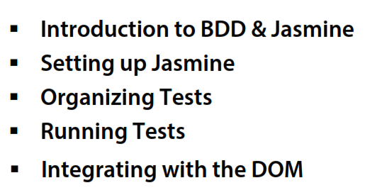
Overview

Slide 4
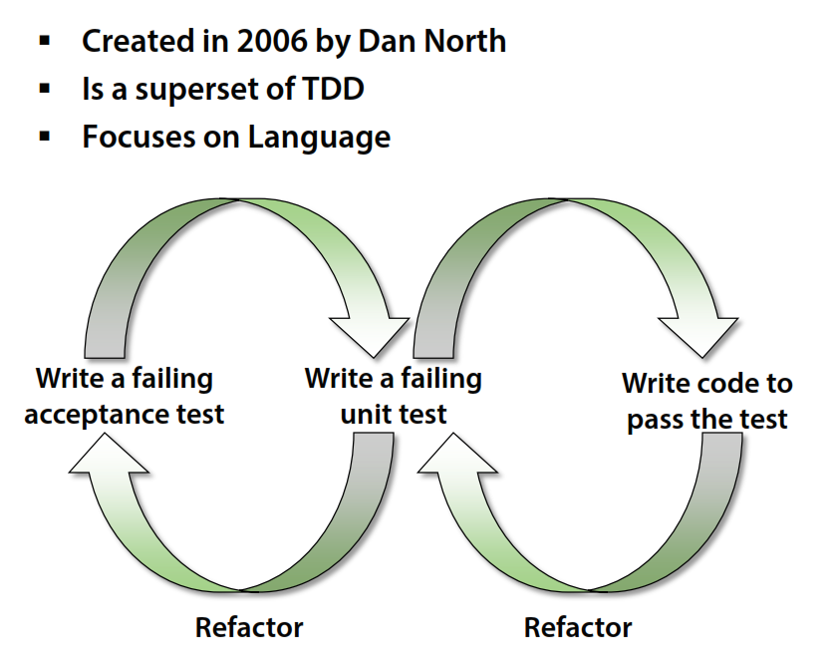
Behavior Driven Development

Slide 5
Setting up Jasmine
Download:
https://github.com/jasmine/jasmine/releases
Documentation:
http://jasmine.github.io/
Create Spec files

Slide 6
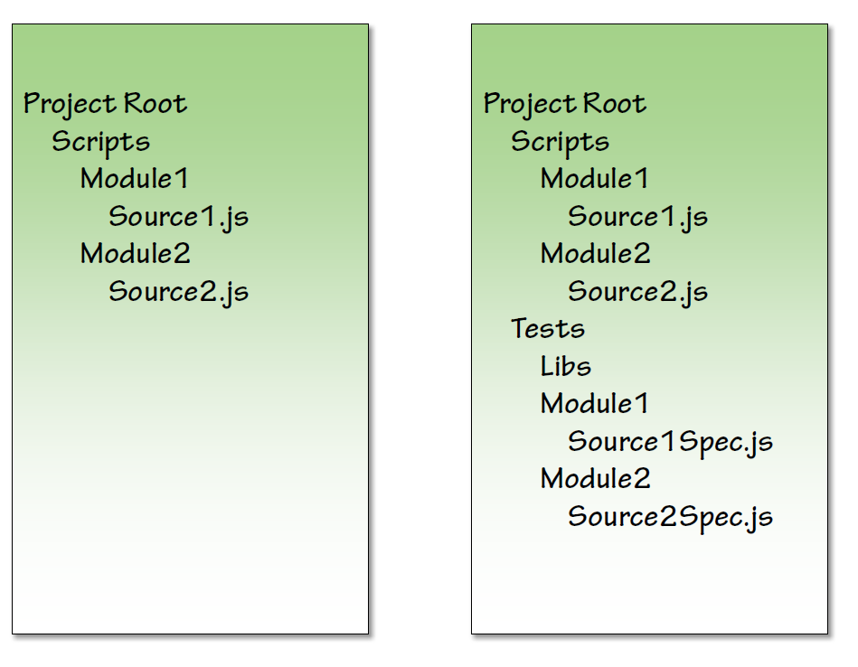
Organizing Tests – Folders & Files

Slide 7
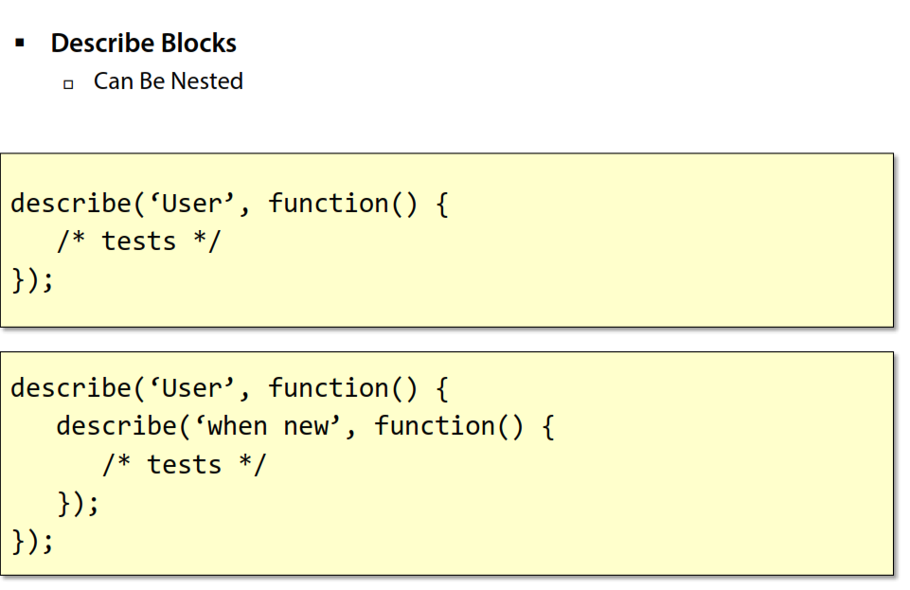
Organizing Jasmine

Slide 8
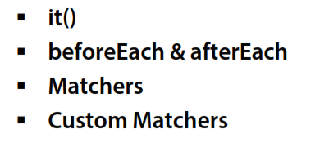
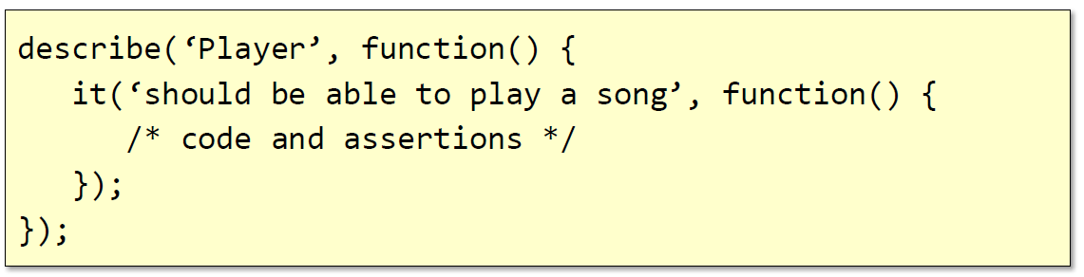
Writing Jasmine Tests

Slide 9
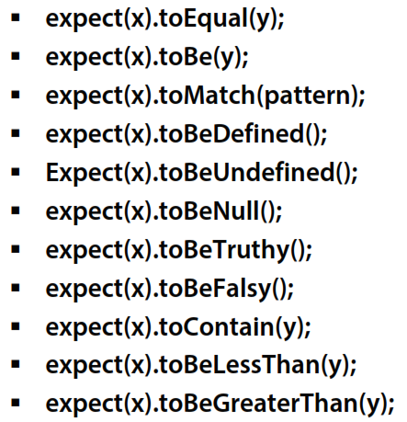
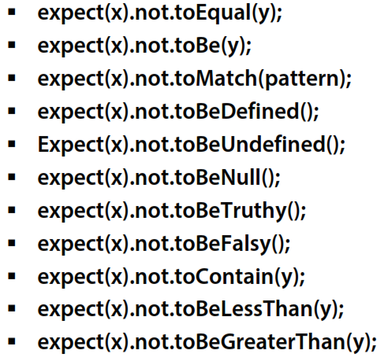
Built-in Matchers

Slide 10
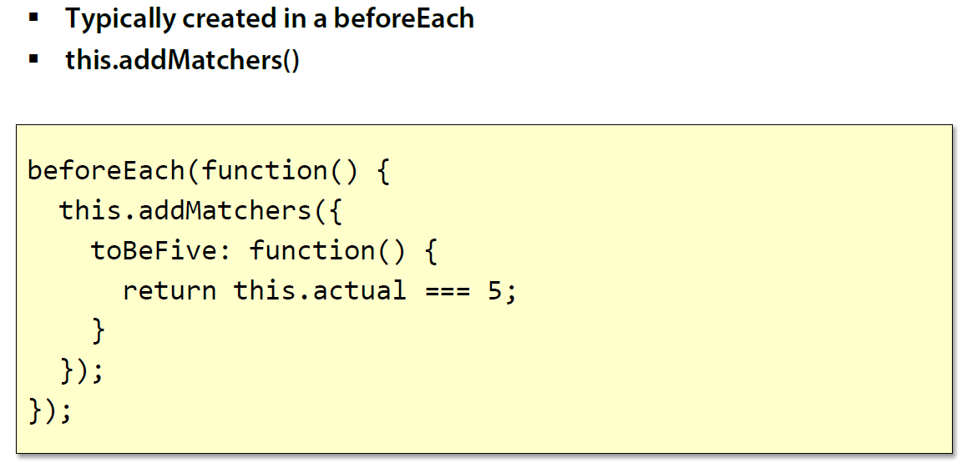
Custom Matcher

Slide 11
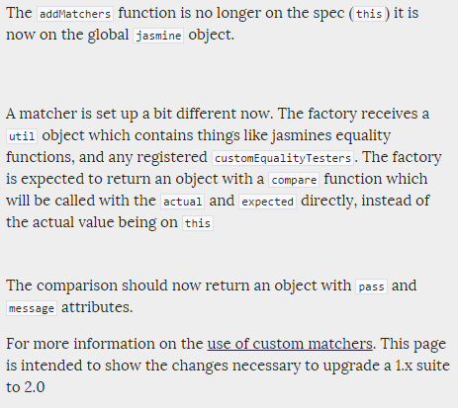
Custom Matcher
http://jasmine.github.io/2.4/upgrading.html

Slide 12
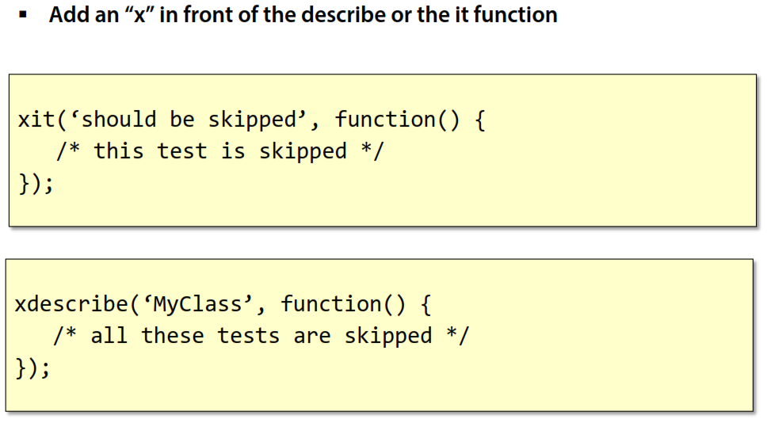
Skipping Tests

Slide 13
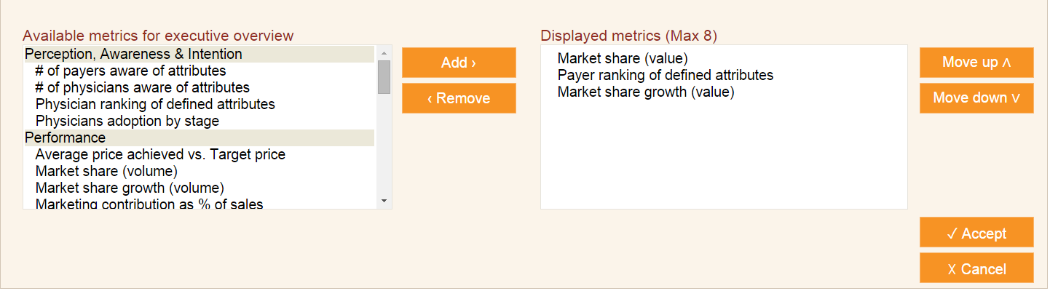
Integration with DOM
Requirements:
There should be at least 1 metric in the ‘Displayed metrics’
There should be at most 8 metric in the ‘Displayed metrics’
If there is only 1 metric in ‘Displayed metrics’, ‘Add’ button should be disabled
If there are 8 metrics in ‘Displayed metrics’, ‘Remove’ button should be disabled
Clicking on a metric should select that
A metric in the ‘Displayed metrics’ list can be moved up/ down etc.

Slide 14
Karma Test Runner

Slide 15
Using Karma
Install karma globally
‘npm install –g karma’
Create package.json
Create Karma config file
‘karma init config.name.js’
Install karma with plugins:
‘npm install karma --save-dev’
‘npm install karma-coverage --save-dev’
‘npm install karma-chrome-launcher --save-dev’
‘npm install karma-firefox-launcher --save-dev’
‘npm install karma-ie-launcher --save-dev’
‘npm install karma-jasmine --save-dev’
‘npm install karma-jasmine-html-reporter --save-dev’

Slide 16
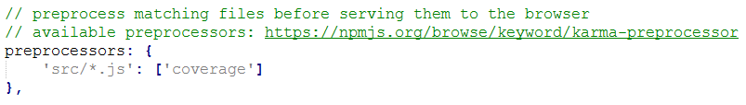

To use coverage:
To use reporters:

Slide 17
Build Automation with Gulp

Slide 18
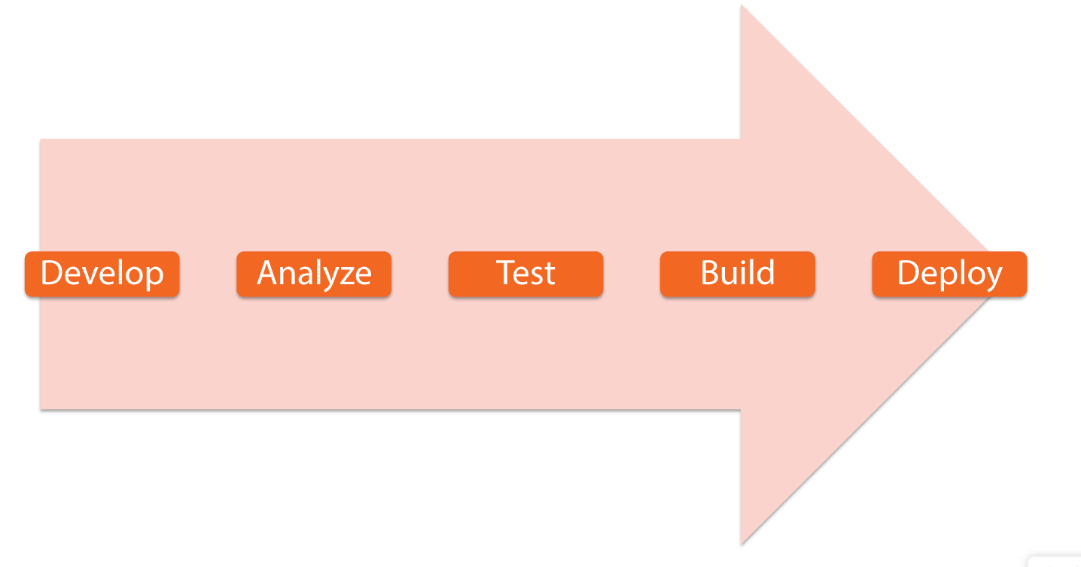
Automated Build Pipeline

Slide 19
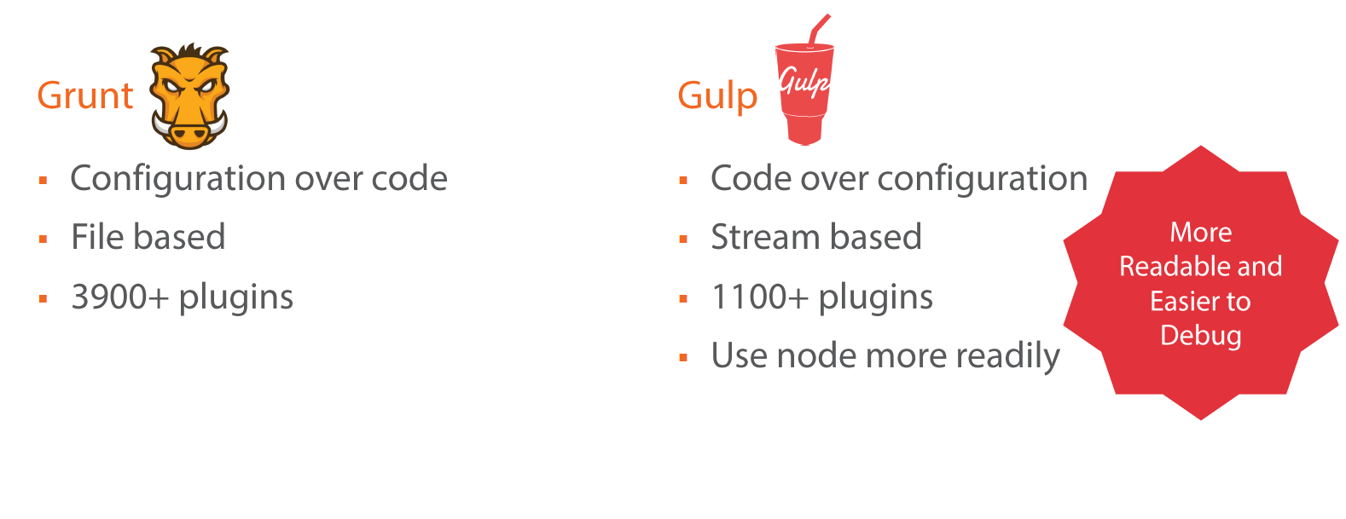
Process automation tools
Grunt, Gulp, Broccoli

Slide 20
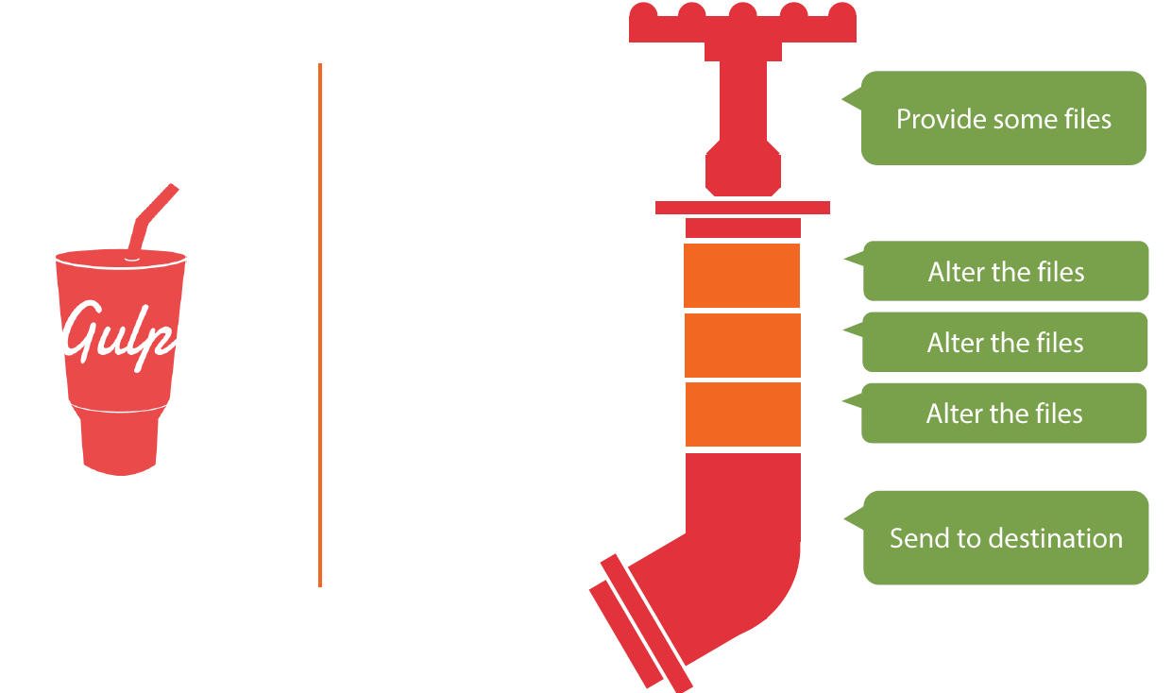
Gulp stream

Slide 21
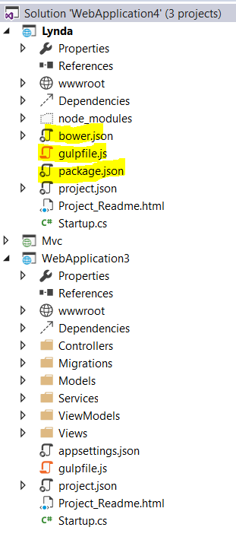
Installing Gulp
By installing Visual Studio 2015 (community edition)
Additionally Install ASP .NET 5 for project with default gulp setup
Benefits:
Auto suggestions
Downloading dependencies when config file is saved
Built-in task-runner explorer
others
By installng Visual Studio 2013 with update 4
Manuall process (for any IDE, including VS. )
Install node.js

Slide 22
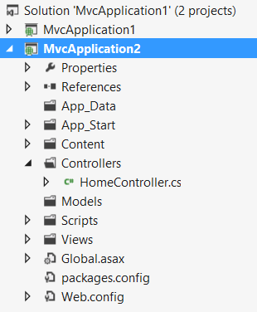
Steps to install gulp in any existing project:
Before:
Run node.js terminal in admin mode
Install gulp globally: ‘npm install –g gulp’
Set default directory to your project directory
e.g: for ‘C:\Users\Raffan\Desktop\GulpTest\MvcApplication2’
Type ‘cd C:\Users\Raffan\Desktop\GulpTest\MvcApplication2’
Create a package.json file:
you can create it manually and setting the content by hand, if you know the structure
http://semver.org/
Install with node.js terminal
Command: ‘npm init’
Set different properties (Name doesn’t take any capital letter)
Install gulp locally: ‘npm install --save-dev gulp’

Slide 23
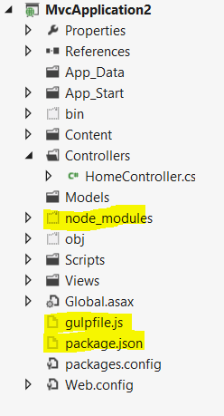
Create ‘gulpfile.js’
Install plugins
Import the plugins in the ‘gupfile.js’
Create tasks.
Run tasks using npm terminal: ‘gulp task_name’

Slide 24
Gulp Commands (API)
Task
Src
Dest
Watch
API documentation:
https://github.com/gulpjs/gulp/blob/master/docs/API.md

Slide 25
Gulp plugins used in the demo
Gulp-concat
Gulp-util
Gulp-uglify
Gulp-rename
browser-sync

Slide 26
Important Gulp-Plugins
General
gulp-concat
gulp-clean
gulp-notify
gulp-livereload
CSS
gulp-sass (convert SASS to CSS)
gulp-less (convert LESS to CSS)
gulp-minify-css (we've already seen that)
gulp-autoprefixer (automatically insert vendor specific prefixes)
gulp-imagemin (to compress images)
JavaScript
gulp-jshint (linting for JavaScript)
gulp-uglify (we've already seen that)
gulp-jscs (checks if a provided style guide is violated)
gulp-jsdoc (extracts documentation)
Caching and more
gulp-cached (filter to exclude unchanged files and cache result)
gulp-remember (filter to combine with previous, but omitted, result)
gulp-changed (filter to only reduce to only changed files)

Slide 27
Useful links
http://www.codeproject.com/Articles/865943/An-introduction-to-Gulp

Slide 28
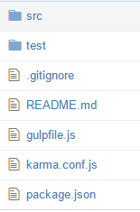
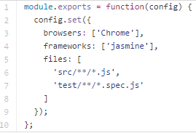
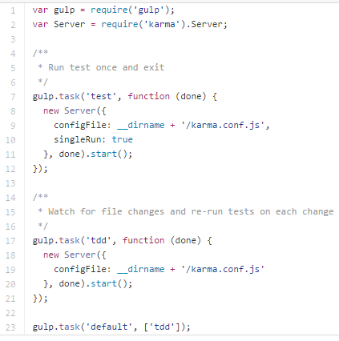
Gulp-Karma
https://github.com/karma-runner/gulp-karma
Project structure
Karma config file
Gulp config file

